Slide 1
Ethics in Information Technology, Fourth Edition
Chapter 6
Intellectual Property
Notes:
‹#›

Slide 2
Objectives
As you read this chapter, consider the following questions:
What does the term intellectual property encompass, and why are organizations so concerned about protecting intellectual property?
What are the strengths and limitations of using copyrights, patents, and trade secret laws to protect intellectual property?
What is plagiarism, and what can be done to combat it?
Ethics in Information Technology, Fourth Edition
‹#›
Notes:
‹#›

Slide 3
Objectives (cont’d.)
What is reverse engineering, and what issues are associated with applying it to create a look-alike of a competitor’s software program?
What is open source code, and what is the fundamental premise behind its use?
What is the essential difference between competitive intelligence and industrial espionage, and how is competitive intelligence gathered?
What is cybersquatting, and what strategy should be used to protect an organization from it?
Ethics in Information Technology, Fourth Edition
‹#›
Notes:
‹#›

Slide 4
What Is Intellectual Property?
Term used to describe works of the mind
Distinct and “owned” or created by a person or group
Books-film-formulas-inventions-music-process
Copyright law
Protects authored works
Patent law
Protects inventions
Trade secret law
Helps safeguard information critical to an organization’s success
Ethics in Information Technology, Fourth Edition
‹#›
Notes:
‹#›

Slide 5
What Is Intellectual Property?
Together, copyright, patent, and trade secret legislation forms a complex body of law that addresses the ownership of intellectual property.
Potential ethical problems with such laws
Stifle creativity
While inventors want to control and get compensation
Million dollar question
Should the need for ongoing innovation or the rights of property owners govern how intellectual property is used?
Ethics in Information Technology, Fourth Edition
‹#›
Notes:
‹#›

Slide 6
What Is Intellectual Property?
Defining and controlling levels of access to IP are complex tasks
Incase of software
Sometimes an expression, which is protected under copyright
Sometimes process of changing computer’s internal structure, protected under patent law
Ethics in Information Technology, Fourth Edition
‹#›
Notes:
‹#›

Slide 7
Copyrights
Established in the U.S. Constitution
Article I, Section 8, Clause 8
Grants creators of original works the exclusive right to:
Distribute
Display
Perform
Reproduce work
Prepare derivative works based upon the work
Author may grant exclusive right to others
Ethics in Information Technology, Fourth Edition
‹#›
Notes:
‹#›

Slide 8
Copyrights (cont’d.)
Copyright protection is granted to the creators of “original works of authorship in any tangible medium of expression, now known or later developed, from which they can be perceived, reproduced, or otherwise communicated, either directly or with the aid of a machine or device.”
The author may grant this exclusive right to others.
Ethics in Information Technology, Fourth Edition
‹#›

Slide 9
Copyrights (cont’d.)
Copyright infringement
is a violation of the rights secured by the owner of a copyright.
Infringement occurs when someone copies a substantial and material part of another’s copyrighted work without permission.
Piracy?
Ethics in Information Technology, Fourth Edition
‹#›

Slide 10
Copyrights (cont’d.)
Copyright term
Copyright law guarantees developers the rights to their works for a certain amount of time
Sonny Bono Copyright Term Extension Act
Created after 1/1/78, life of the author plus 70 years
Created but not published or registered before 1/1/78, life of the author plus 70 years; no expiration before 12/31/2004
Created before 1978 still in original or renewable term of copyright, 95 years from the date the copyright was originally secured
Ethics in Information Technology, Fourth Edition
‹#›

Slide 11
Copyrights (cont’d.)
Types of work that can be copyrighted
Architecture
Art
Audiovisual works
Choreography
Drama
Graphics
Literature
Motion pictures
Ethics in Information Technology, Fourth Edition
‹#›
Notes:
‹#›

Slide 12
Copyrights (cont’d.)
Types of work that can be copyrighted (cont’d.)
Music
Pictures
Sculptures
Sound recordings
Other intellectual works:
As described in Title 17 of U.S. Code
Copyright laws flexible for new technologies
Software, games, multimedia, web pages etc
Ethics in Information Technology, Fourth Edition
‹#›
Notes:
‹#›

Slide 13
Copyrights (cont’d.)
Must fall within one of the preceding categories
Must be original
Evaluating originality can cause problems
Works not eligible for copyright
Not fixed in tangible form
Common terms, no original authorship
Ethics in Information Technology, Fourth Edition
‹#›
Notes:
‹#›

Slide 14
Copyrights (cont’d.)
Fair use doctrine
Allows portions of copyrighted materials to be used without permission under certain circumstances
Maintains balance between protecting an author’s rights and enabling public access to copyrighted works
Factors to consider when evaluating the use of copyrighted material
Ethics in Information Technology, Fourth Edition
‹#›
Notes:
‹#›

Slide 15
Copyrights (cont’d.)
Fair use doctrine factors include:
Purpose and character of the use
Nature of the copyrighted work
Portion of the copyrighted work used
Effect of the use upon the value of the copyrighted work
Key concept: an idea cannot be copyrighted, but the expression of an idea can be
No copyright infringement if two parties develop similar work
Ethics in Information Technology, Fourth Edition
‹#›
Notes:
‹#›

Slide 16
Copyrights (cont’d.)
The Prioritizing Resources and Organization for Intellectual Property (PRO-IP) Act of 2008
Increased enforcement and substantially increased penalties for infringement
General Agreement on Tariffs and Trade (GATT)
Trade agreement between 117 countries
Created World Trade Organization (WTO)
Despite GATT, copyright protection varies greatly from country to country
Ethics in Information Technology, Fourth Edition
‹#›

Slide 17
Copyrights (cont’d.)
The WTO and the WTO TRIPS Agreement (1994)
Many nations recognize that intellectual property has become increasingly important in world trade
Established minimum levels of protection that each government must provide to the intellectual property of members
Covers copyright, patents, and trade secrets
Ethics in Information Technology, Fourth Edition
‹#›
Notes:
‹#›

Slide 18
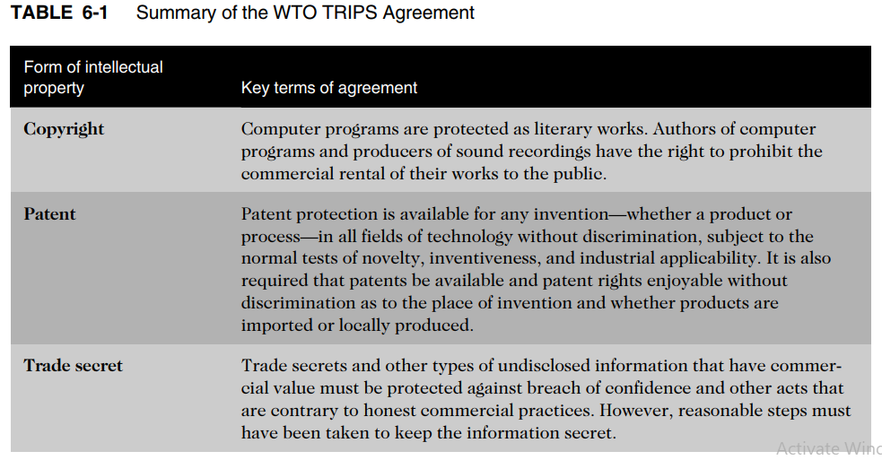
Copyrights (cont’d.)
Ethics in Information Technology, Fourth Edition
‹#›
Notes:
‹#›

Slide 19
Copyrights (cont’d.)
World Intellectual Property Organization (WIPO)
Agency of the United Nations
Advocates for the interests of intellectual property owners
WIPO Copyright Treaty provides additional copyright protections for electronic media
Ethics in Information Technology, Fourth Edition
‹#›

Slide 20
Copyrights (cont’d.)
Digital Millennium Copyright Act (DMCA)
Implementation of WIPO treaty
Civil and criminal penalties included
Governs distribution of tools and software that can be used to circumvent technological measures used to protect copyrighted works
Provides safe harbors for ISPs whose customers/subscribers may be breaking copyright laws
ISP must comply with “notice and takedown procedures” that grant copyright holders a process to halt access to alleged infringing content
Ethics in Information Technology, Fourth Edition
‹#›

Slide 21
Copyrights (cont’d.)
Digital Millennium Copyright Act (DMCA)
The DMCA added new provisions, making it an offense to do the following:
Circumvent a technical protection
Develop and provide tools that allow others to access a technologically protected work
Manufacture, import, provide, or traffic in tools that enable others to circumvent protection and copy a protected work
Example to follow
Ethics in Information Technology, Fourth Edition
‹#›

Slide 22
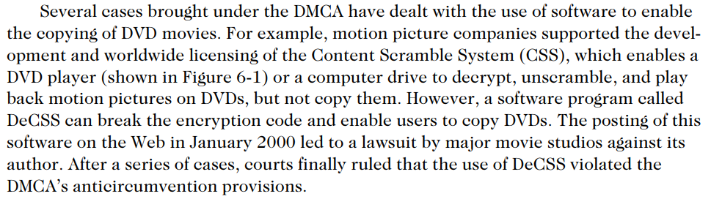
Copyrights (cont’d.)
Ethics in Information Technology, Fourth Edition
‹#›

Slide 23
Copyrights (cont’d.)
Digital Millennium Copyright Act (DMCA)
Opponents of DMCA say that it gives holders of intellectual property so much power that it actually restricts the free flow of information.
For example, under DMCA, Internet service providers (ISPs) are required to remove access to Web sites that allegedly break copyright law—even before infringement has been proven.
Companies that provide Internet access to music and videos face legal action and the failure of their businesses if they do not gain approval to publish content from the music and movie industries.
Ethics in Information Technology, Fourth Edition
‹#›

Slide 24
Patents
Grant of property right to inventors
Issued by the U.S. Patent and Trademark Office (USPTO)
Permits an owner to exclude the public from making, using, or selling the protected invention
Allows legal action against violators
Prevents independent creation as well as copying
Extends only to the United States and its territories and possessions
Ethics in Information Technology, Fourth Edition
‹#›
Notes:
‹#›

Slide 25
Patents (cont’d.)
Applicant must file with the USPTO
USPTO searches prior art
Takes an average of 35.3 months from filing an application until application is issued as a patent or abandoned
Prior art
Existing body of knowledge
Ethics in Information Technology, Fourth Edition
‹#›
Notes:
‹#›

Slide 26
Patents (cont’d.)
An invention must pass four tests
Must be in one of the five statutory classes of items
Must be useful
Must be novel
Must not be obvious to a person having ordinary skill in the same field
Items cannot be patented if they are:
Abstract ideas
Laws of nature
Natural phenomena
Ethics in Information Technology, Fourth Edition
‹#›
Notes:
‹#›

Slide 27
Patents (cont’d.)
Patent infringement
Making unauthorized use of another’s patent
No specified limit to the monetary penalty
Most common defense is counterattack
Plaintiff must still prove that every element of the claim was infringed
Infringement caused some kind of financial loss
Ethics in Information Technology, Fourth Edition
‹#›
Notes:
‹#›

Slide 28
Patents (cont’d.)
Software patent
Protects feature, function, or process embodied in instructions executed on a computer
20,000 software-related patents per year have been issued since the early 1980s
Some experts think the number of software patents being granted inhibits new software development
Ethics in Information Technology, Fourth Edition
‹#›
Notes:
‹#›

Slide 29
Patents (cont’d.)
Software patent
Prior to 1981, the courts regularly turned down requests for such patents, giving the impression that software could not be patented.
In the 1981 Diamond v. Diehr case, the Supreme Court granted a patent to Diehr, who had developed a process control computer and sensors to monitor the temperature inside a rubber mold.
The USPTO interpreted the court’s reasoning to mean that just because an invention used software did not mean that the invention could not be patented.
Ethics in Information Technology, Fourth Edition
‹#›
Notes:
‹#›

Slide 30
Patents (cont’d.)
Software patent
Since the early 1980s, the USPTO has granted as many as 20,000 software-related patents per year.
Applications software, business software, expert systems, and system software have been patented, as well as such software processes as compilation routines, editing and control functions, and operating system techniques.
Even electronic font types and icons have been patented
Ethics in Information Technology, Fourth Edition
‹#›
Notes:
‹#›

Slide 31
Patents (cont’d.)
Before obtaining a software patent, do a patent search
Software Patent Institute is building a database of information
Too many software patents inhibiting new software development
Example to follow
Ethics in Information Technology, Fourth Edition
‹#›
Notes:
‹#›

Slide 32
Patents (cont’d.)
In October 1999, Amazon.com sued Barnes & Noble for allegedly infringing this patent with its Express Lane feature.
The filing of the suit prompted many complaints about the issuing of patents to business methods, which critics deride as overly broad and unoriginal concepts that do not merit patents.
Some critics considered one-click shopping little more than a simple combination of existing Web technologies.
Following preliminary court hearings and the discovery that others had used the one-click technology before Amazon.com even began business, Amazon.com and Barnes & Noble settled out of court in March 2002.
Ethics in Information Technology, Fourth Edition
‹#›
Notes:
‹#›

Slide 33
Patents (cont’d.)
Software engineers rarely take the time to search patent databases for new inventions that could benefit their projects,
partly because software patents are described in obscure language
partly because engineers risk paying triple damages for knowingly infringing one.
As a result, many software patent infringements are for independent inventions—example to follow
Ethics in Information Technology, Fourth Edition
‹#›
Notes:
‹#›

Slide 34
Patents (cont’d.)
Software engineers rarely take the time to search patent databases for new inventions
Cygnus Systems alleged in late 2008 that Apple, Google, and Microsoft infringed a patent that Cygnus filed for in 2001.
Cygnus says that the three firms violated its patent on use of document-preview icons, or thumbnails.
Cygnus alleges that Apple’s iPhone, Safari Internet browser, and Mac OS X Leopard operating systems; Google’s Chrome browser; and Microsoft’s Vista OS operating system and Internet Explorer 8 all employ this technology.
Because this is such a commonly used technology, many more companies may be sued for patent infringement.
Ethics in Information Technology, Fourth Edition
‹#›
Notes:
‹#›

Slide 35
Patents (cont’d.)
Software cross-licensing agreements
Large software companies agree not to sue each other over patent infringements
For example, Microsoft is working to put in place 100 or more agreements with firms such as IBM 2010
This strategy to obtain the rights to technologies that it might use in its products provides a tremendous amount of development freedom to Microsoft without risk of expensive litigation
Small businesses have no choice but to license patents if they use them
Ethics in Information Technology, Fourth Edition
‹#›
Notes:
‹#›

Slide 36
Patents (cont’d.)
Defensive publishing
Alternative to filing for patents
Company publishes a description of the innovation
Establishes the idea’s legal existence as prior art
Costs mere hundreds of dollars
No lawyers
Fast
Patent troll firm
Acquires patents with no intention of manufacturing anything; instead, licensing the patents to others
Ethics in Information Technology, Fourth Edition
‹#›
Notes:
‹#›

Slide 37
Patents (cont’d.)
Patent troll firm
Intellectual Ventures is an example of such a firm; it has built a portfolio of more than 20,000 patents, most for IT-related technology.
Google, Intel, eBay, NVIDIA, SAP, Sony, Microsoft, Nokia, and other IT firms invested money in Intellectual Ventures in exchange for licenses to patents in the portfolio.
Some IT organizations pay large amounts of money for the right to use one or more of these patents
Ethics in Information Technology, Fourth Edition
‹#›
Notes:
‹#›

Slide 38
Patents (cont’d.)
Standard is a definition or format
Approved by recognized standards organization or accepted as a de facto standard by the industry
Enables hardware and software from different manufacturers to work together
Ethics in Information Technology, Fourth Edition
‹#›
Notes:
‹#›

Slide 39
Patents (cont’d.)
Submarine patent
Patented process/invention hidden within a standard
Standards exist for communication protocols, programming languages, operating systems, data formats, and electrical interfaces
Standards are extremely useful because they enable hardware and software from different manufacturers to work together
Does not surface until standard is broadly adopted
Ethics in Information Technology, Fourth Edition
‹#›
Notes:
‹#›

Slide 40
Patents (cont’d.)
Patent farming involves:
Influencing a standards organization to make use of a patented item without revealing the existence of the patent
Demanding royalties from all parties that use the standard
Example
Ethics in Information Technology, Fourth Edition
‹#›
Notes:
‹#›

Slide 41
Patents (cont’d.)
Patent farming involves:
One possible example of a submarine patent used in patent farming could be U.S. Patent 5,838,906, which is owned by the University of California and licensed exclusively to a small software company called Eolas Technologies.
The patent describes how a Web browser can use external applications.
The University of California did not make the patent known for years and then sued Microsoft for use of the principle detailed in the patent.
Ethics in Information Technology, Fourth Edition
‹#›
Notes:
‹#›

Slide 42
Patents (cont’d.)
Patent farming involves:
The university and Eolas received a $520 million award in August 2003 after a federal jury found that Microsoft’s Internet Explorer browser infringed the patent.
In November 2003, the patent office began a review of the patent based on a request from world-renowned Tim BernersLee, father of the World Wide Web and director of the World Wide Web Consortium. He argued that the 1998 patent should be invalidated because of the existence of prior art, or previous examples of the technology’s use. In January 2004, a federal judge upheld the original decision, requiring Microsoft to pay $520 million on grounds that Internet Explorer infringed the patent.
Ethics in Information Technology, Fourth Edition
‹#›
Notes:
‹#›

Slide 43
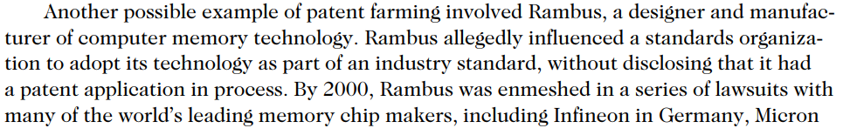
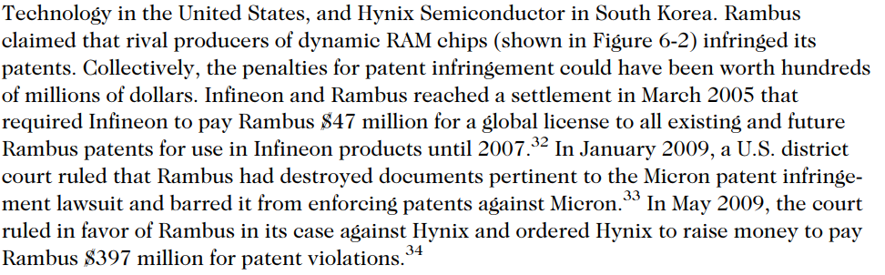
Patents (cont’d.)
Patent farming involves:
Ethics in Information Technology, Fourth Edition
‹#›
Notes:
‹#›

Slide 44
Trade Secrets
Trade secret
Business information
Represents something of economic value
Requires an effort or cost to develop
Some degree of uniqueness or novelty
Generally unknown to the public
Kept confidential
Information is only considered a trade secret if the company takes steps to protect it
Ethics in Information Technology, Fourth Edition
‹#›
Notes:
‹#›

Slide 45
Trade Secrets (cont’d.)
Trade secret law has a few key advantages over patents and copyrights
No time limitations
No need to file an application
Patents can be ruled invalid by courts
No filing or application fees
Law doesn’t prevent someone from using the same idea if it is developed independently
Trade secret law varies greatly from country to country
Ethics in Information Technology, Fourth Edition
‹#›
Notes:
‹#›

Slide 46
Trade Secret Laws
Uniform Trade Secrets Act (UTSA)
Established uniformity across the states in area of trade secret law
Computer hardware and software can qualify for trade secret protection
The Economic Espionage Act (EEA) of 1996
Penalties of up to $10 million and 15 years in prison for the theft of trade secrets
Ethics in Information Technology, Fourth Edition
‹#›
Notes:
‹#›

Slide 47
Employees and Trade Secrets
Employees are the greatest threat to trade secrets
Unauthorized use of an employer’s customer list
Customer list is not automatically considered a trade secret
Educate workers about the confidentiality of lists
Nondisclosure clauses in employee’s contract
Enforcement can be difficult
Confidentiality issues are reviewed at the exit interview
Ethics in Information Technology, Fourth Edition
‹#›

Slide 48
Employees and Trade Secrets
Defining reasonable nondisclosure agreements can be difficult, as seen in the following example involving Apple.
In addition to filing hundreds of patents on iPhone technology, the firm put into place a restrictive nondisclosure agreement to provide an extra layer of protection.
Many iPhone developers complained bitterly about the tough restrictions, which prohibited them from talking about their coding work with anyone not on the project team and even prohibited them from talking about the restrictions themselves.
Eventually, Apple admitted that its nondisclosure terms were overly restrictive and loosened them for iPhone software that was already released
Ethics in Information Technology, Fourth Edition
‹#›

Slide 49
Employees and Trade Secrets
For example, the Ohio State Supreme Court upheld a verdict against a man who left a financial services firm and recruited former clients to start his own firm. His former employer sued him, even though the former employee had not stolen a client list. “This ruling says, it doesn’t matter if the confidential list is on paper or in your memory if it qualifies as a trade secret
Ethics in Information Technology, Fourth Edition
‹#›

Slide 50
Employees and Trade Secrets (cont’d.)
Noncompete agreements
Protect intellectual property from being used by competitors when key employees leave
Require employees not to work for competitors for a period of time
Wide range of treatment on noncompete agreements among the various states
Examples
Ethics in Information Technology, Fourth Edition
‹#›
Notes:
‹#›

Slide 51
Employees and Trade Secrets (cont’d.)
Noncompete agreements
The employee agrees as a condition of employment that in the event of termination for any reason, he or she will not engage in a similar or competitive business for a period of two years, nor will he or she contact or solicit any customer with whom Employer conducted business during his or her employment. This restrictive covenant shall be for a term of two years from termination, and shall encompass the geographic area within a 100-mile radius of Employer’s place of business.
Ethics in Information Technology, Fourth Edition
‹#›
Notes:
‹#›

Slide 52
Employees and Trade Secrets (cont’d.)
Noncompete agreements
IBM sued Mark Papermaster, a microchip expert, for violating a noncompete agreement when he announced that he intended to leave the company to join Apple as its head of device hardware engineering. The lawsuit was settled when Papermaster agreed to report to IBM should he suspect that any breakthroughs he develops at Apple infringe on proprietary or confidential information he learned while working at IBM. Papermaster must also twice submit to IBM a written declaration that states he is not using confidential IBM material in his role at Apple
Ethics in Information Technology, Fourth Edition
‹#›
Notes:
‹#›

Slide 53
Key Intellectual Property Issues
Issues that apply to intellectual property and information technology
Plagiarism
Reverse engineering
Open source code
Competitive intelligence
Trademark infringement
Cybersquatting
Ethics in Information Technology, Fourth Edition
‹#›
Notes:
‹#›

Slide 54
Plagiarism
Stealing someone’s ideas or words and passing them off as one’s own
Many students:
Do not understand what constitutes plagiarism
Believe that all electronic content is in the public domain
Plagiarism is also common outside academia
Plagiarism detection systems
Check submitted material against databases of electronic content
Ethics in Information Technology, Fourth Edition
‹#›
Notes:
‹#›

Slide 55
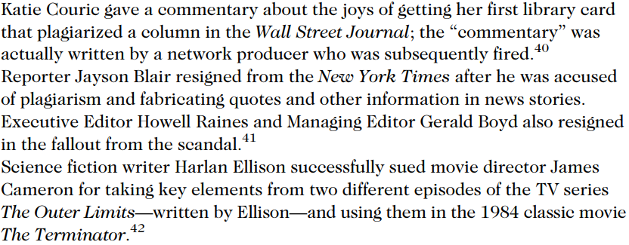
Plagiarism Examples
Ethics in Information Technology, Fourth Edition
‹#›

Slide 56
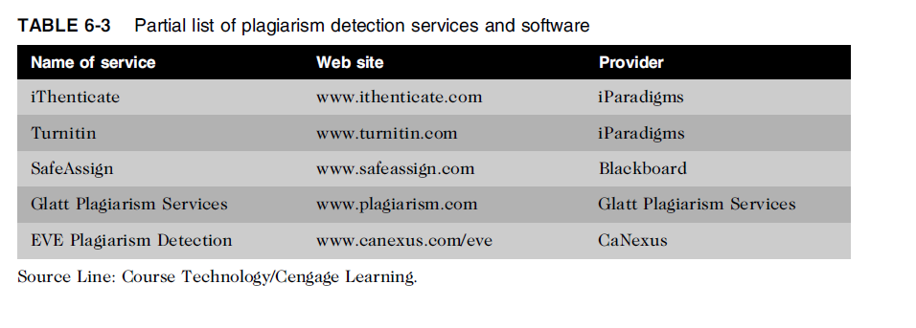
Plagiarism (cont’d.)
Ethics in Information Technology, Fourth Edition
‹#›
Notes:
‹#›

Slide 57
Plagiarism (cont’d.)
Steps to combat student plagiarism
Help students understand what constitutes plagiarism and why they need to cite sources
Show students how to document Web pages
Schedule major writing assignments in portions due over the course of the term
Tell students that instructors are aware of Internet paper mills and plagiarism detection services
Incorporate detection into an antiplagiarism program
Ethics in Information Technology, Fourth Edition
‹#›
Notes:
‹#›

Slide 58
Reverse Engineering
Process of taking something apart in order to:
Understand it
Build a copy of it
Improve it
Applied to computer:
Hardware
Software
Convert a program code to a higher-level design
Ethics in Information Technology, Fourth Edition
‹#›
Notes:
‹#›

Slide 59
Reverse Engineering
Convert an application that ran on one vendor’s database to run on another’s
Reverse engineering – Forward engineering
No issue doing this in-house
Unethical if done outside
Licensed, copyright, patent issues maybe raised
Not illegal if
Interoperability
Not protected
Ethics in Information Technology, Fourth Edition
‹#›
Notes:
‹#›

Slide 60
Reverse Engineering (cont’d.)
Compiler
Language translator
Converts computer program statements expressed in a source language to machine language
Software manufacturer
Provides software in machine language form
Decompiler
Reads machine language
Produces source code
Gain access to information copyrighted or trade secrete
Ethics in Information Technology, Fourth Edition
‹#›
Notes:
‹#›

Slide 61
Reverse Engineering (cont’d.)
Courts have ruled in favor of reverse engineering:
To enable interoperability
Example
Sega Enterprises Ltd. v. Accolade, Inc
An appeals court ultimately ruled that if someone lacks access to the unprotected elements of an original work and has a “legitimate reason” for gaining access to those elements, disassembly of a copyrighted work is considered to be a fair use under section 107 of the Copyright Act
To restrict manufacturer monopoly
Ethics in Information Technology, Fourth Edition
‹#›
Notes:
‹#›

Slide 62
Reverse Engineering (cont’d.)
Software license agreements forbid reverse engineering in USA
Ethics of using reverse engineering are debated
Fair use if it provides useful function/interoperability
Especially when documentation is not provided
Can uncover designs that someone else has developed at great cost and taken care to protect
Ethics in Information Technology, Fourth Edition
‹#›
Notes:
‹#›

Slide 63
Open Source Code
Program source code made available for use or modification:
As users or other developers see fit
Basic premise
Many programmers can help software improve
Can be adapted to meet new needs
Bugs rapidly identified and fixed
High reliability
Ethics in Information Technology, Fourth Edition
‹#›
Notes:
‹#›

Slide 64
Open Source Code
Reasons why source code is created
Some people share code to earn respect for solving a common problem in an elegant way.
Some people have used open source code that was developed by others and feel the need to pay back
A firm may be required to develop software as part of an agreement to address a client’s problem. If firm is paid for the employees’ time spent to develop software rather than for the software itself, it may decide to license the code as open source and use it either to promote firm’s expertise or as an incentive to attract other potential clients with similar problem
GNU General Public License (GPL) was a precursor to the Open Source Initiative (OSI)
Ethics in Information Technology, Fourth Edition
‹#›
Notes:
‹#›

Slide 65
Open Source Code
Reasons why source code is created
A firm may develop open source code in the hope of earning software maintenance fees if end users need changes in the future.
A firm may develop useful code but may be reluctant to license and market it, and so might donate the code to the general public.
Open source license
Bob Jacobsen vs Matthew A. Katzer case
Ethics in Information Technology, Fourth Edition
‹#›
Notes:
‹#›

Slide 66
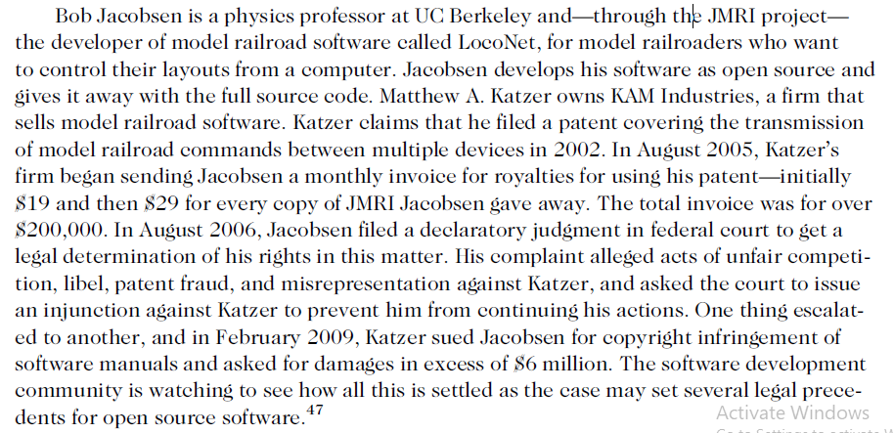
Open Source Code
Ethics in Information Technology, Fourth Edition
‹#›
Notes:
‹#›

Slide 67
Competitive Intelligence
Gathering of legally obtainable information
To help a company gain an advantage over rivals
Often integrated into a company’s strategic plans and decision making
Not the same as industrial espionage, which uses illegal means to obtain business information not available to the general public
Without proper management safeguards, it can cross over to industrial espionage
Dirty tricks ?
Ethics in Information Technology, Fourth Edition
‹#›
Notes:
‹#›

Slide 68
Competitive Intelligence
Without proper management safeguards, it can cross over to industrial espionage
One frequent trick is to enter a bar near a competitor’s plant or headquarters, strike up a conversation, and ply people for information after their inhibitions have been weakened by alcohol
Competitive intelligence analysts must avoid unethical or illegal actions, such as lying, misrepresentation, theft, bribery, or eavesdropping with illegal devices
P&G vs Uniliver case – page 218
Ethics in Information Technology, Fourth Edition
‹#›
Notes:
‹#›

Slide 69
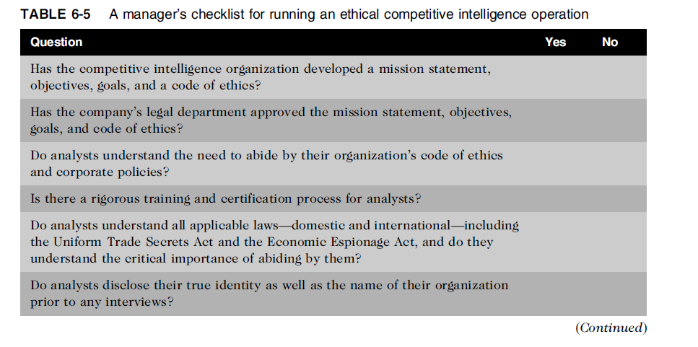
Competitive Intelligence (cont’d.)
Ethics in Information Technology, Fourth Edition
‹#›
Notes:
‹#›

Slide 70
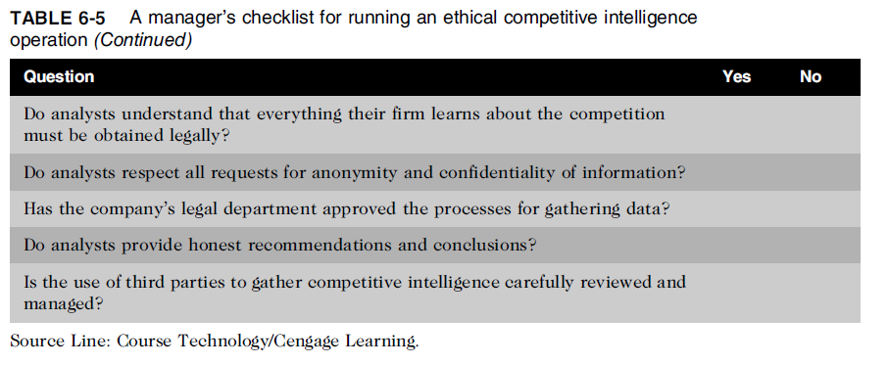
Competitive Intelligence (cont’d.)
Ethics in Information Technology, Fourth Edition
‹#›
Notes:
‹#›

Slide 71
Trademark Infringement
Trademark is logo, package design, phrase, sound, or word that enables consumer to differentiate one company’s product from another’s
Trademark owner can prevent others from using the same mark or a confusingly similar mark on a product’s label
Organizations frequently sue one another over the use of a trademark in a Web site or domain name
Nominative fair use is defense often employed by defendant in trademark infringement case
Ethics in Information Technology, Fourth Edition
‹#›

Slide 72
Cybersquatting
Cybersquatters
Register domain names for famous trademarks or company names
Hope the trademark’s owner will buy the domain name for a large sum of money
To curb cybersquatting, register all possible domain names
.org, .com, .info
Ethics in Information Technology, Fourth Edition
‹#›
Notes:
‹#›

Slide 73
Cybersquatting (cont’d.)
Internet Corporation for Assigned Names and Numbers (ICANN)
Several top-level domains (.com, .edu, edu., .gov, .int, .mil, .net, .org, aero, .biz, .coop, .info, .museum, .name, .pro, .asis, .cat, .mobi, .tel, and .travel)
Current trademark holders are given time to assert their rights in the new top-level domains before registrations are opened to the general public
Anticybersquatting Consumer Protection Act allows trademark owners to challenge foreign cybersquatters
Ethics in Information Technology, Fourth Edition
‹#›
Notes:
‹#›

Slide 74
Cybersquatting (cont’d.)
OnlineNIC was one of the very first domain registrars licensed by ICANN. During 2008, Verizon Communications, Microsoft, and Yahoo! each filed separate lawsuits against OnlineNIC because that firm registered hundreds of domain names identical or similar to their trademark names (e.g., verizon-cellular.com, encarta.com, and yahoozone.com). In December 2008, Verizon was awarded damages of $31.15 million. OnlineNIC was prohibited from registering any additional names containingVerizon trademarks, and it was ordered to transfer the disputed domain names to Verizon
Ethics in Information Technology, Fourth Edition
‹#›
Notes:
‹#›

Slide 75
Summary
Intellectual property is protected by laws for:
Copyrights
Patents
Trademarks
Trade secrets
Plagiarism is stealing and passing off the ideas and words of another as one’s own
Reverse engineering
Process of breaking something down in order to understand, build a copy of, or improve it
Ethics in Information Technology, Fourth Edition
‹#›
Notes:
‹#›

Slide 76
Summary (cont’d.)
Open source code
Made available for use or modification as users or other developers see fit
Competitive intelligence
Uses legal means and public information
Trademark infringement
Use of other’s trademark in a Web site can lead to issues
Cybersquatting
Registration of a domain name by an unaffiliated party
Ethics in Information Technology, Fourth Edition
‹#›
Notes:
‹#›

